Slide 1
Workflow of IPv4 layer and Routing in NS3
AODV
Presented By:
1705043
1705053
1705060

Slide 2
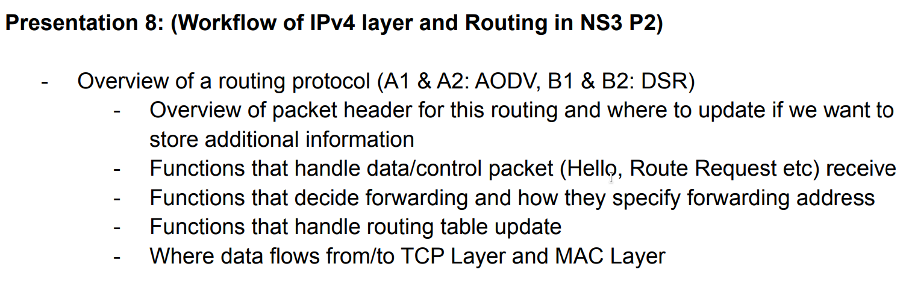

Slide 3
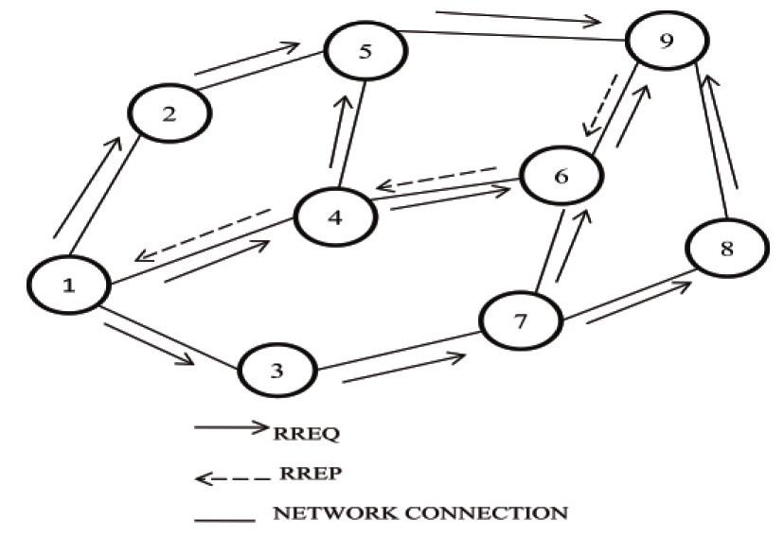
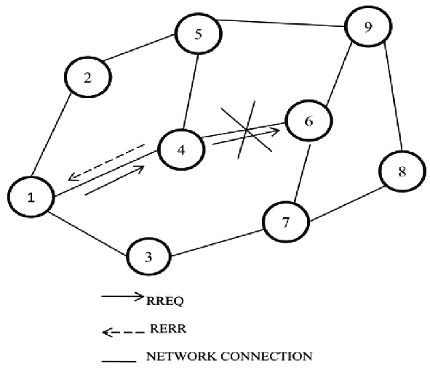
AODV
ROUTE Discovery
ROUTE Maintenance
Discover all the routes using RREQ (Broadcast until destination reach)
Destination will unicast RREP to source (Unicast)

Slide 4
Overview of packet header for this routing (AODV) and
where to update if we want to store additional information

Slide 5
AODV Packet Headers
RreqHeader
RrepHeader
RerrHeader
RrepAckHeader
TypeHeader

Slide 6
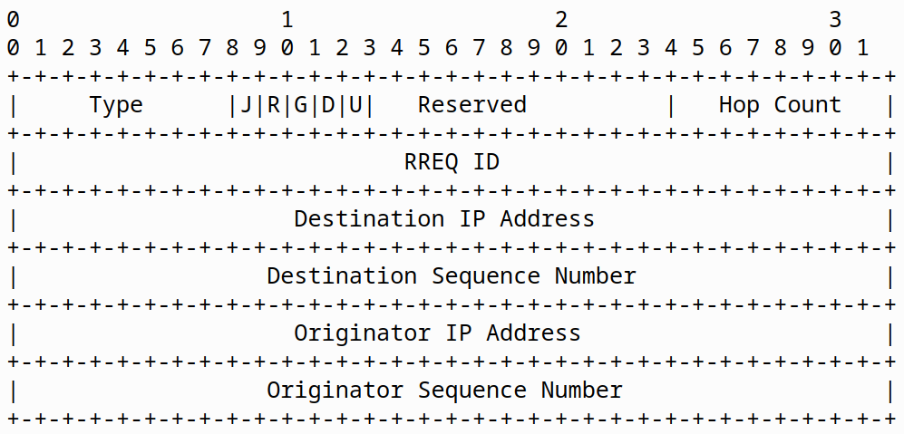
RreqHeader

Slide 7
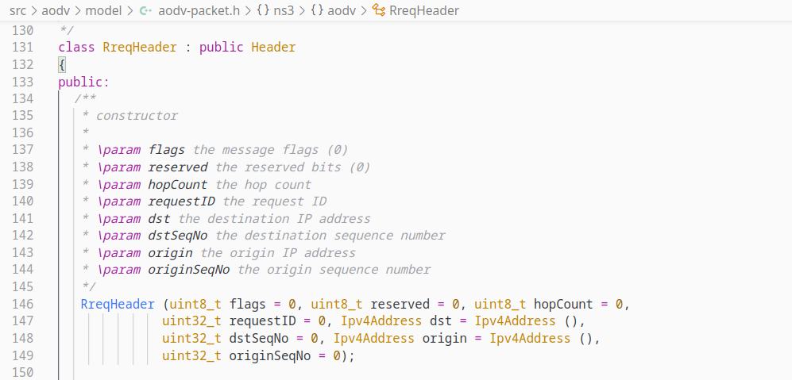
RreqHeader

Slide 8
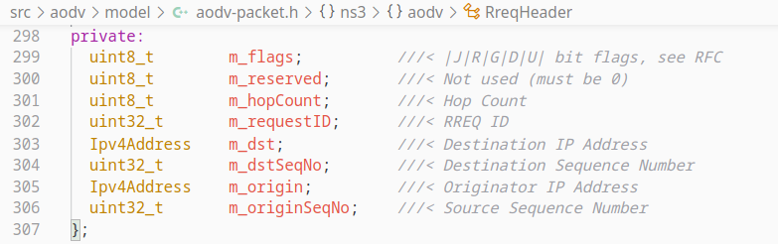
RreqHeader

Slide 9
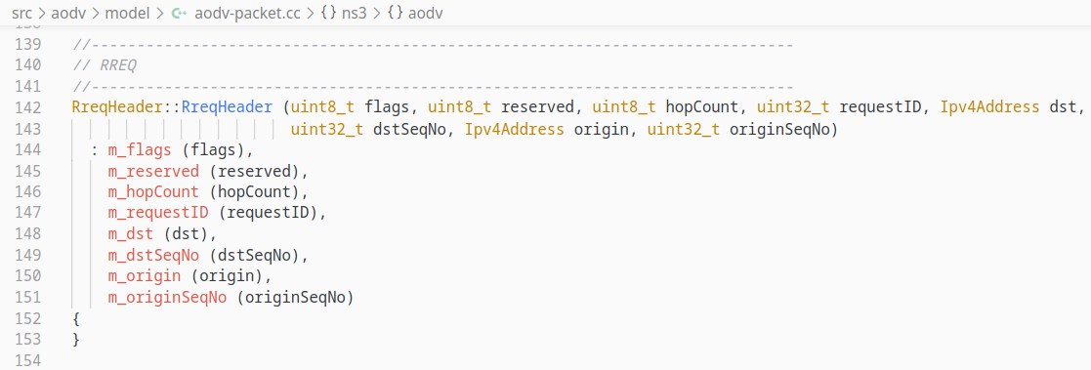
RreqHeader

Slide 10
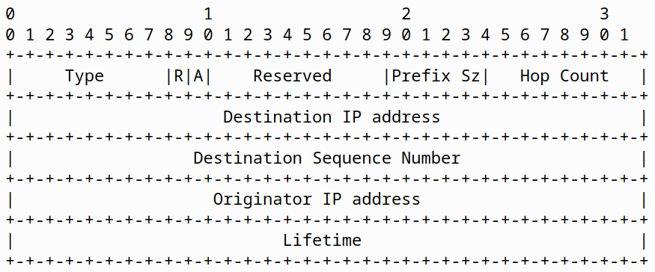
RrepHeader

Slide 11
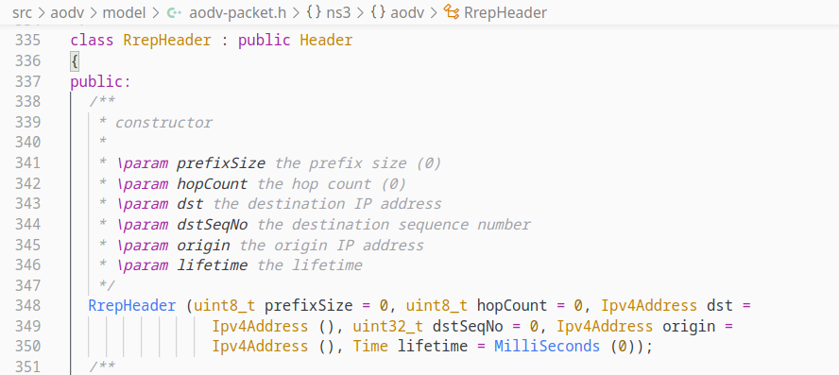
RrepHeader

Slide 12
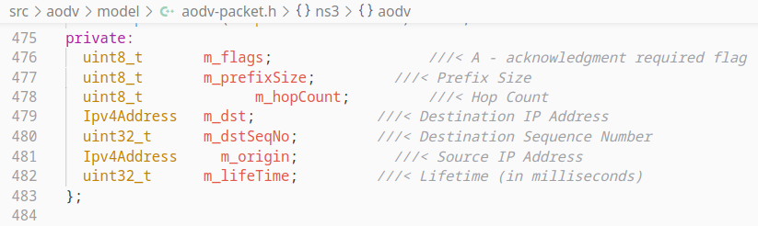
RrepHeader

Slide 13
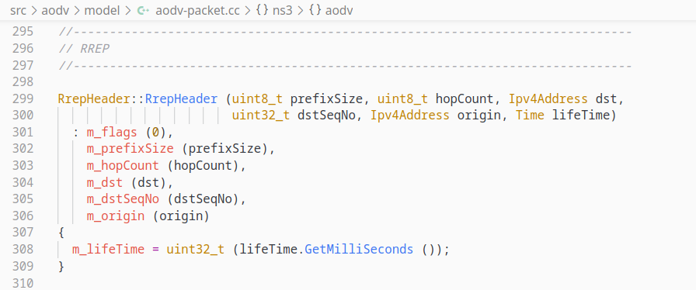
RrepHeader

Slide 14
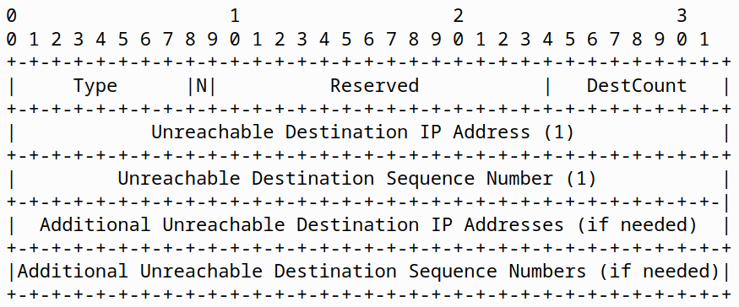
RerrHeader

Slide 15
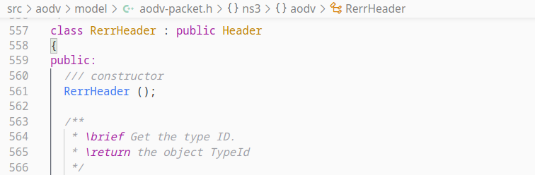
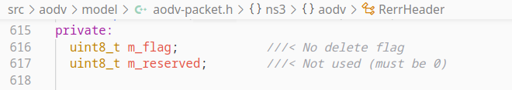
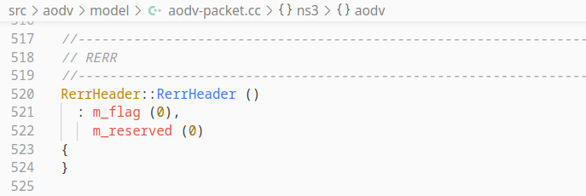
RerrHeader

Slide 16
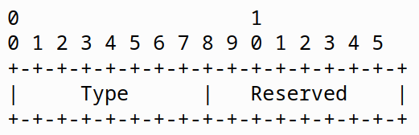
RrepAckHeader

Slide 17
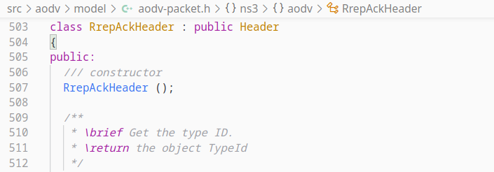
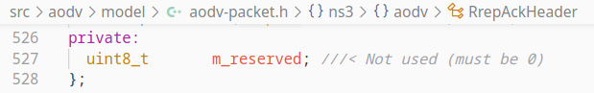
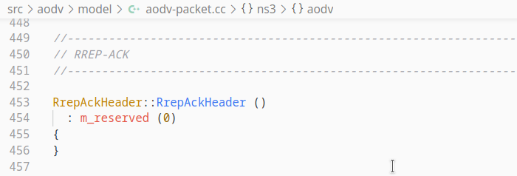
RrepAckHeader

Slide 18
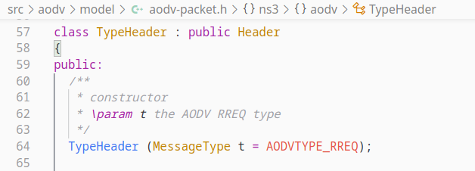
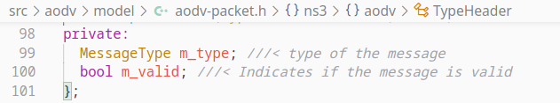
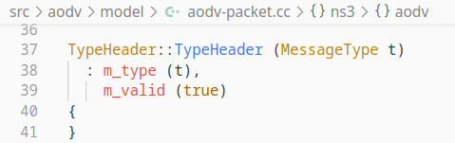
TypeHeader

Slide 19
Functions That handle Data/Control Packet Receive
The following functions involve packet receive,
void RecvAodv (Ptr< Socket > socket)
void RecvRequest (Ptr< Packet > p, Ipv4Address receiver, Ipv4Address src)
void RecvReply (Ptr< Packet > p, Ipv4Address my, Ipv4Address src)
void RecvReplyAck (Ipv4Address neighbor)
void RecvError (Ptr< Packet > p, Ipv4Address src)
Source : https://www.nsnam.org/docs/release/3.35/doxygen/aodv-routing-protocol_8cc_source.html

Slide 20
RecvAodv() Function
This function receives and processes control packets.
It has a socket parameter which is used to extract the packet.
It checks the validity of the packet.
Then calls the corresponding function of that packet type.
It also updates the route to neighbor.

Slide 21
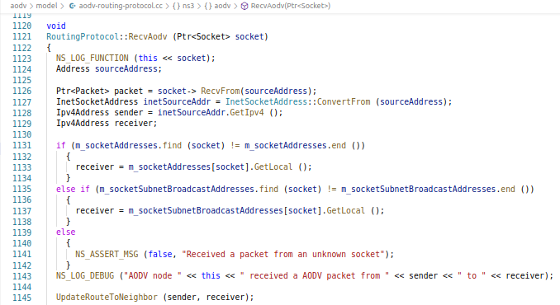
RecvAodv() Function

Slide 22
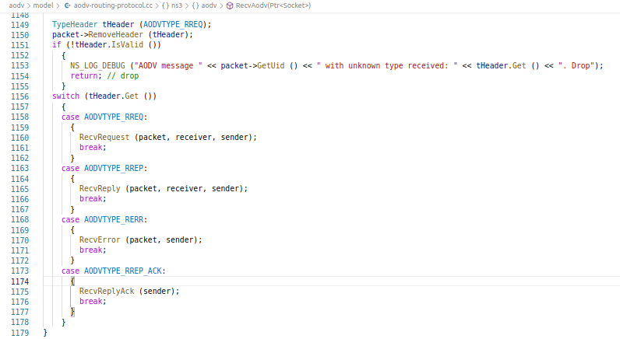
RecvAodv() Function

Slide 23
RecvRequest() Function
This function is used to receive RREQ packet.
It ignores duplicate packets and packets from blacklisted nodes.
Then it increments RREQ hop count and creates or updates reverse route.
If the neighbor is not found in routing table, then it creates a new entry.
Now if the node itself is the destination or has an active route to the destination, then a Reply packet(RREP) is generated and function is returned.
It also checks if TTL is exceeded.
And at last, it is broadcasted.

Slide 24
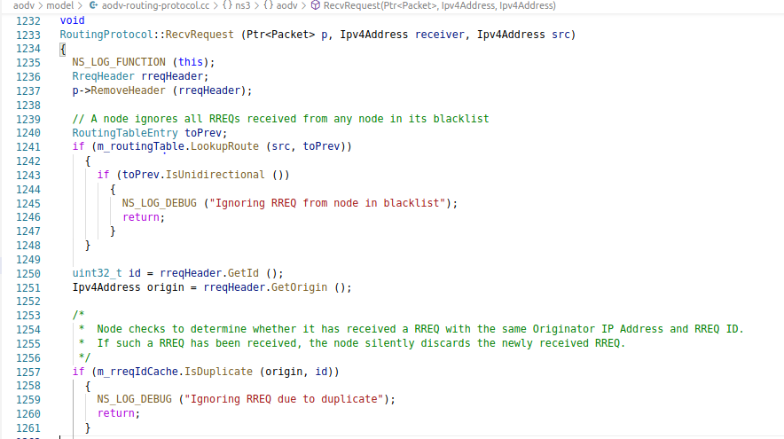
RecvRequest() Function

Slide 25
RecvReply() Function
It is used to receive RREP packet.
If the reply is a hello message, the node should make sure that it has an active route and otherwise, it will create one using ProcessHello() function.
The forward route for this destination is created if it does not already exist. Otherwise, the node compares the destination sequence no with its own stored destination sequence no and upon comparison, the routing table entry is updated.
If current node is not the destination node, the RREP packet is forwarded to the node determined by its routing table entry.
Then it is acknowledged by sending RREP-ACK packet back.
It also checks if TTL is exceeded.

Slide 26
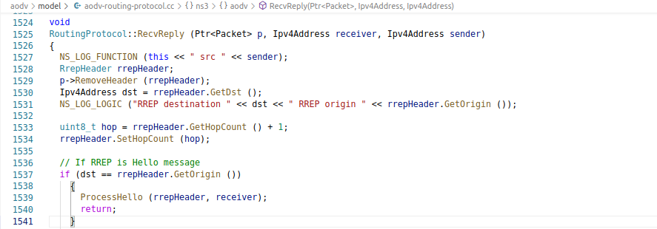
RecvReply() Function

Slide 27
RecvError() Function
It is used to receive RERR packet.
It is sent when a node breaks or a route error happens.
It lists unreachable destinations consisting unreachable neighbor and destinations that use the unreachable neighbor as next hop.
It creates the precursor list with affected neighbors.
Then it again send RERR packets to the precursors.
It then invalidates routes with unreachable destinations.

Slide 28
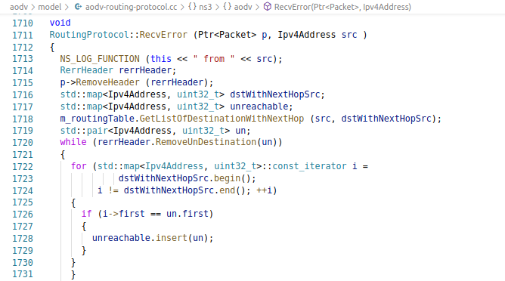
RecvError() Function

Slide 29
RecvReplyAck() Function
It is used for RREP_ACK packet.
It just sets the Route Flags and update routing table.

Slide 30
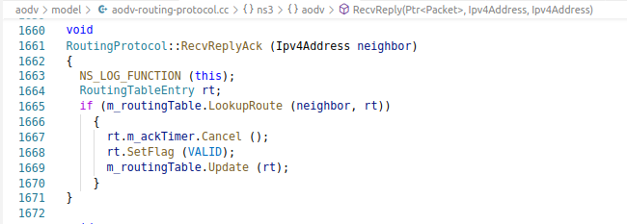
RecvReplyAck() Function

Slide 31
FORWARDING
Two functions are mainly used while forwarding
RouteInput()
Forwarding()
https://www.nsnam.org/doxygen/classns3_1_1aodv_1_1_routing_protocol.html

Slide 32
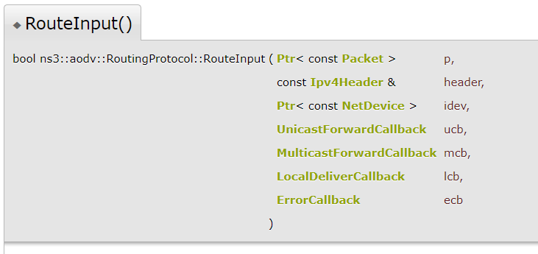
FORWARDING - RouteInput()
Routes an input packet - to be forwarded or locally delivered

Slide 33
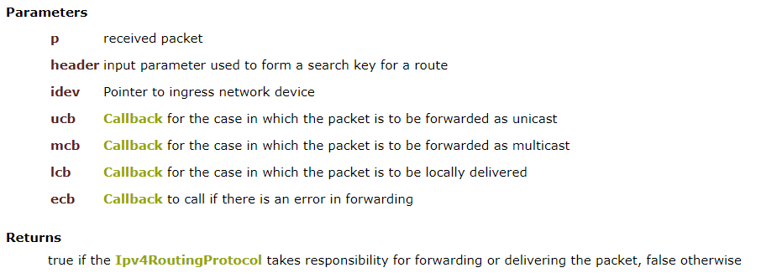
FORWARDING - RouteInput()

Slide 34
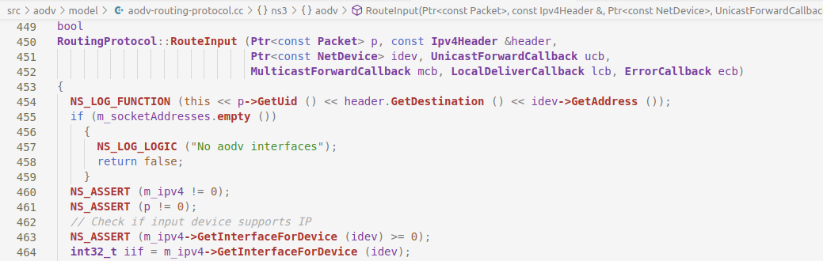
FORWARDING - RouteInput()

Slide 35
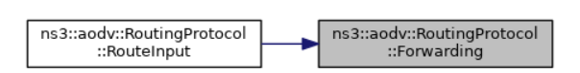
FORWARDING - RouteInput()

Slide 36
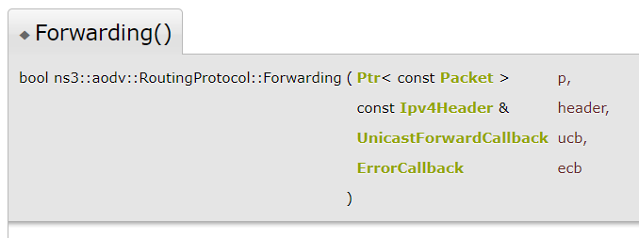
FORWARDING - Forwarding()
If route exists and is valid, forward the packet

Slide 37
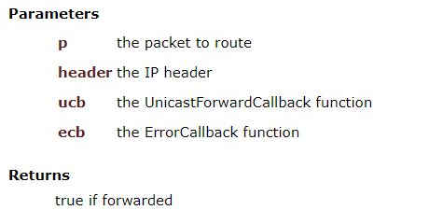
FORWARDING - Forwarding()

Slide 38
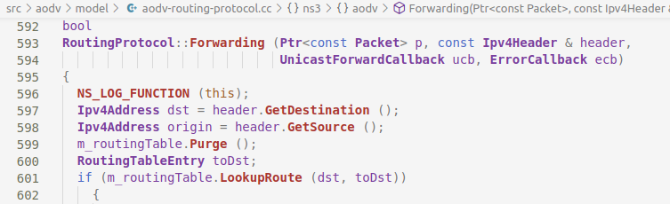
FORWARDING - Forwarding()

Slide 39
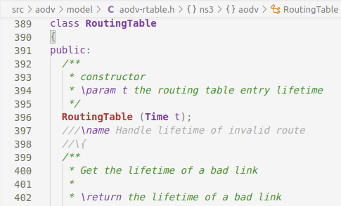
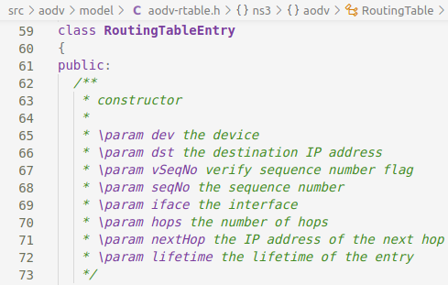
ROUTING TABLE - Classes
https://www.nsnam.org/doxygen/classns3_1_1aodv_1_1_routing_table.html

Slide 40
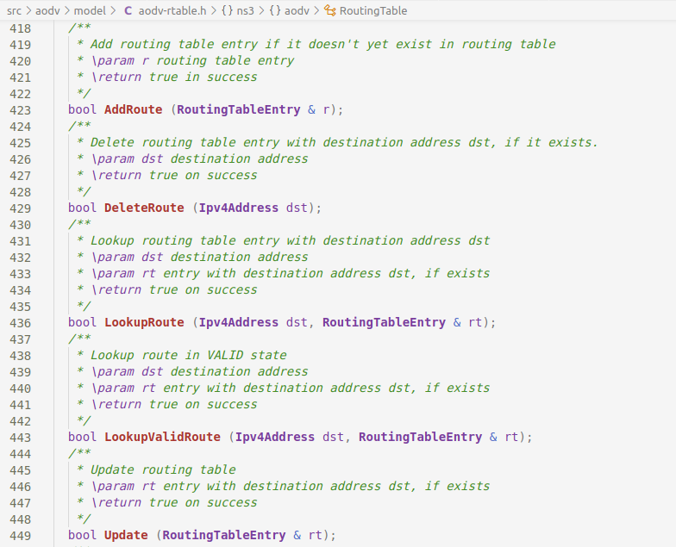
ROUTING TABLE - Basic Functions

Slide 41
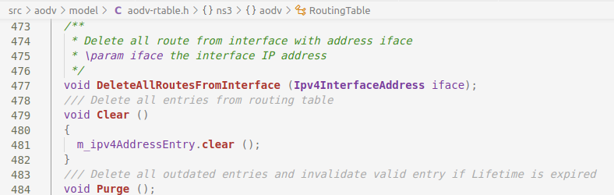
ROUTING TABLE - Basic Functions

Slide 42
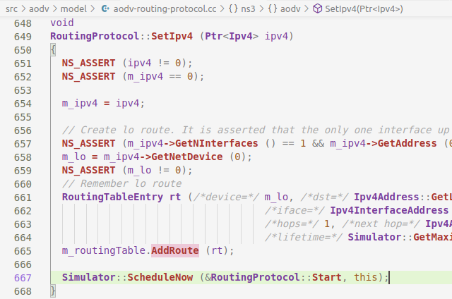
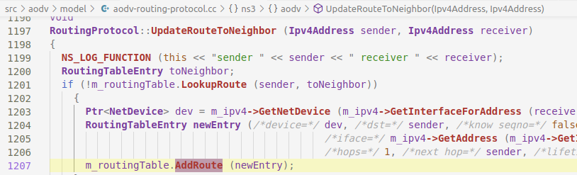
ROUTING TABLE - Adding Route

Slide 43
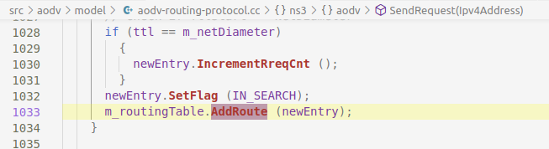
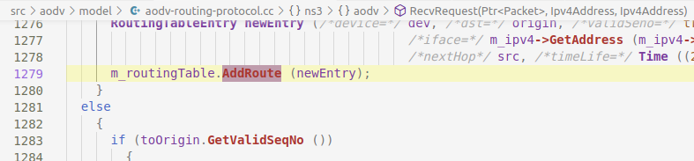
ROUTING TABLE - Adding Route

Slide 44
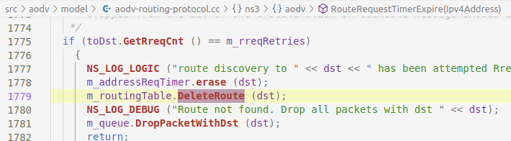
ROUTING TABLE - Deleting Route

Slide 45
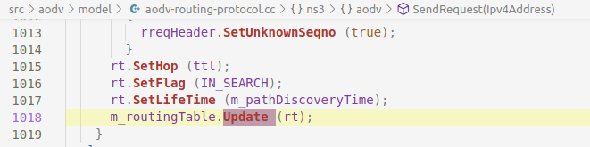
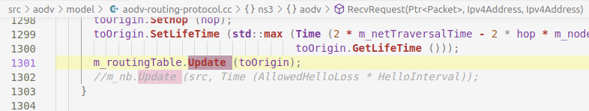
ROUTING TABLE - Updating Route

Slide 46
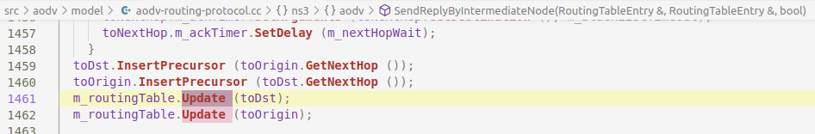
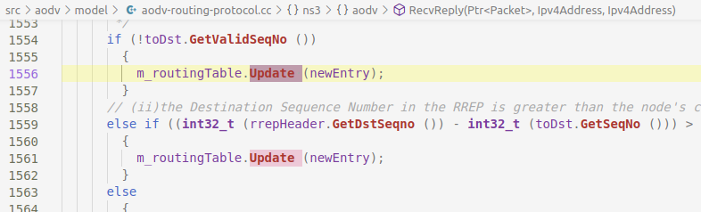
ROUTING TABLE - Updating Route

Slide 47
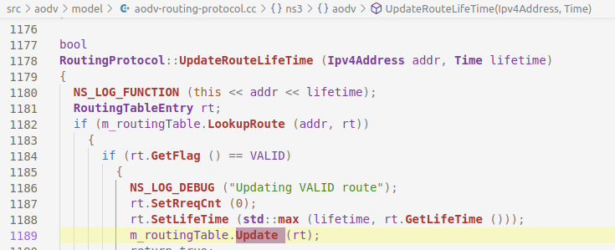
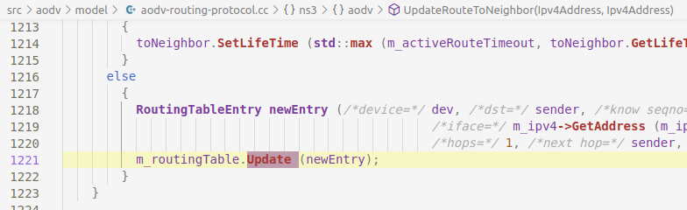
ROUTING TABLE - Updating Route

Slide 48

ROUTING TABLE - Purge

Slide 49
Data flows from/to
TCP Layer and MAC Layer

Slide 50

Run the AODV

Slide 51

Create Devices

Slide 52


MAC Layer

Slide 53



Send Receive

Slide 54

Routing

Slide 55

TCP Protocol

Slide 56

TcpL4Protocol Class

Slide 57

TcpL4Protocol Class

Slide 58

Sending Packet

Slide 59

Receiving Packet

Slide 60
Thank You

